Slide 1

Cyber Minutes Weekly
“Held for Ransom"
11-15-2023 | Jonathan Montoya

Slide 2
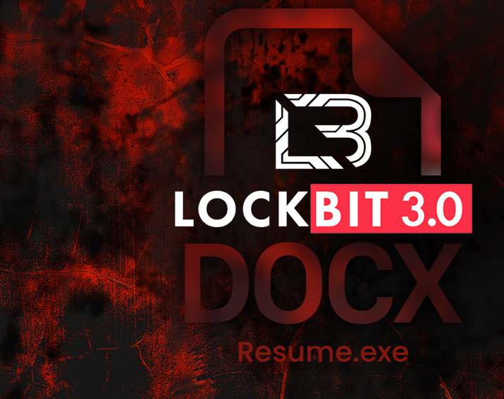

LockBit
Operation functions as a Ransomware-as-a-Service (RaaS)
Charges a subscription fee, upfront payments, or a portion of the profit
Most active in 2022 and 2023
Over 1,700 attacks since 2020 in the U.S.
Active since late 2019

Slide 3
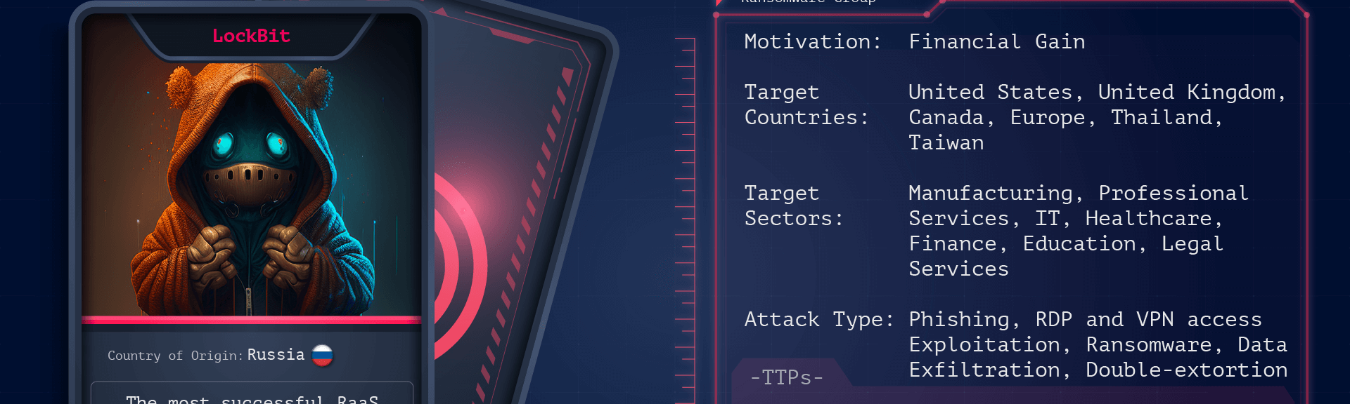

Ran$omware
"Dark Corporations" like DarkSide, Clop, Dark Angels Team, and many more.
Major companies hit including MGM, Boeing, Johnson Controls, Sony, etc.
LockBit has collected over 100M in U.S. ransom payments since 2020
Targets Windows, Linux and now MacOS
LockBit 3.0 builder leaked in late 2022

Slide 4
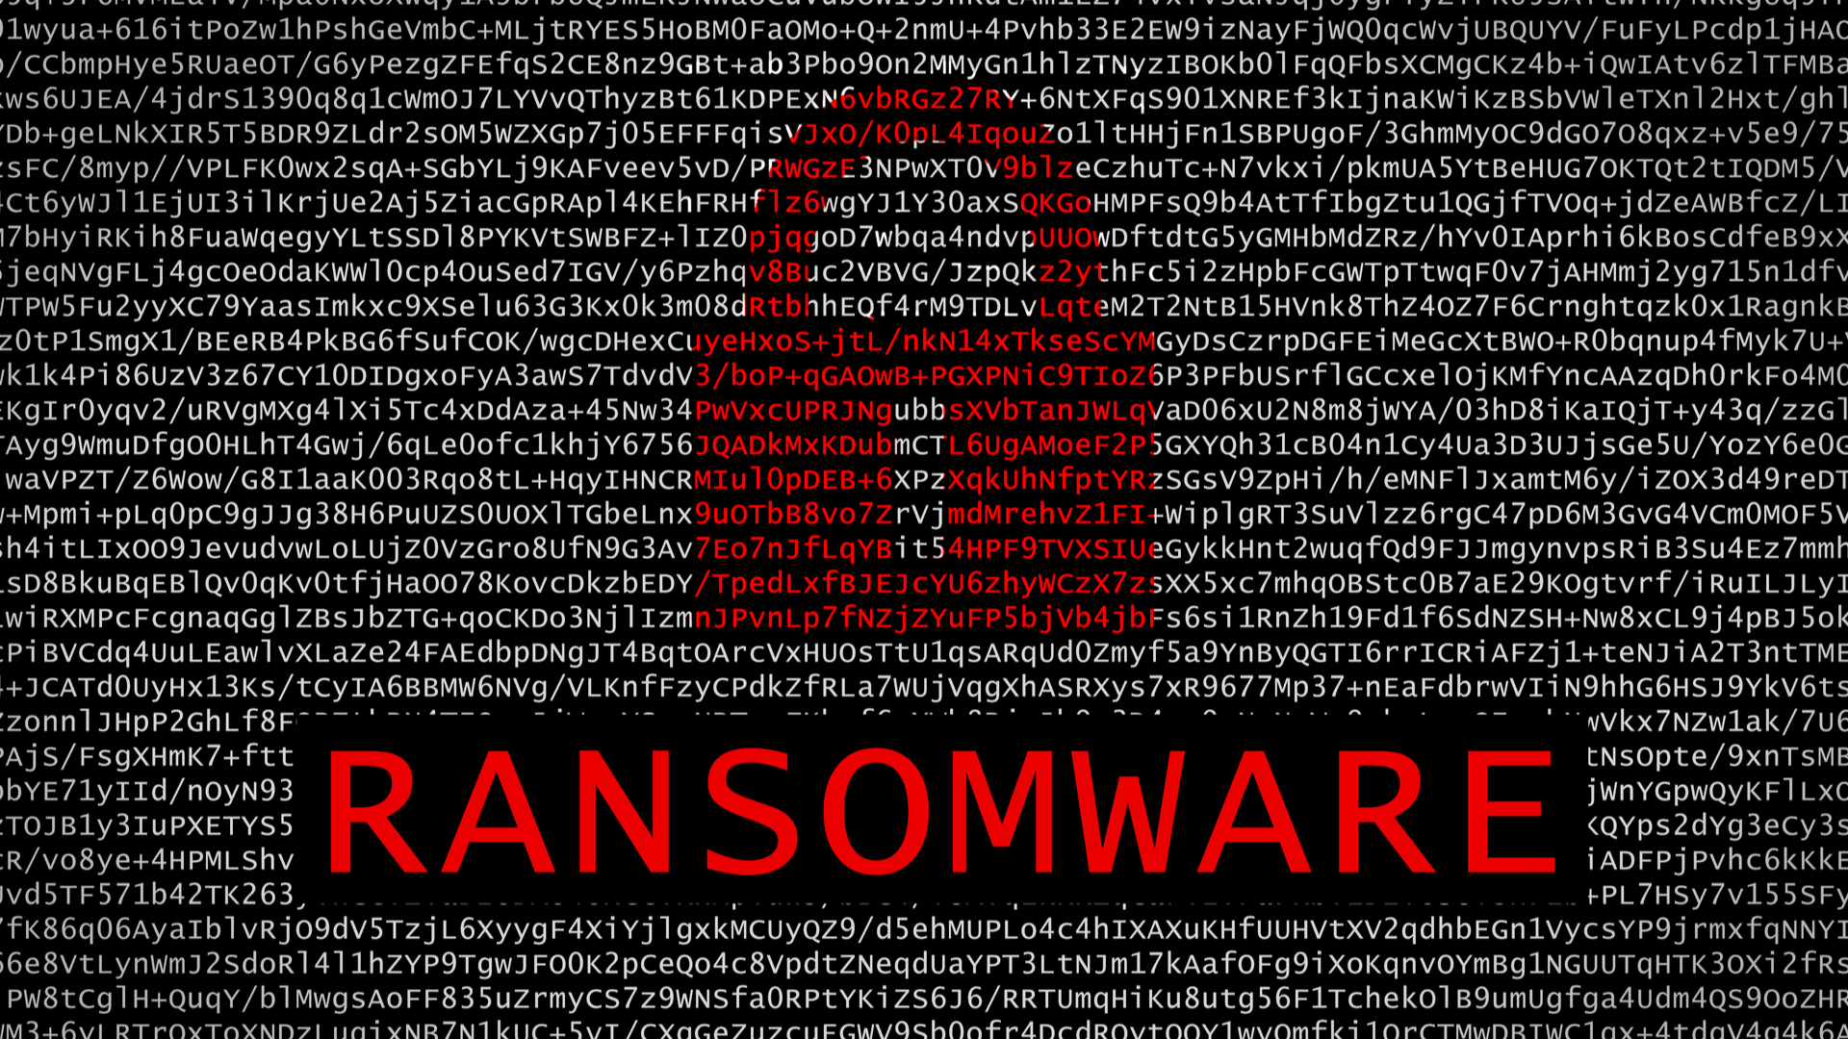
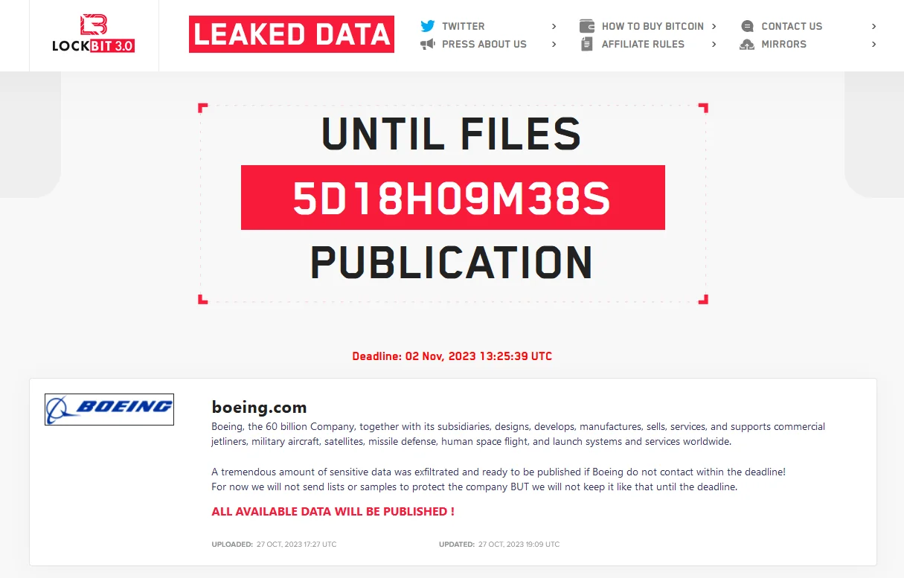

Slide 5

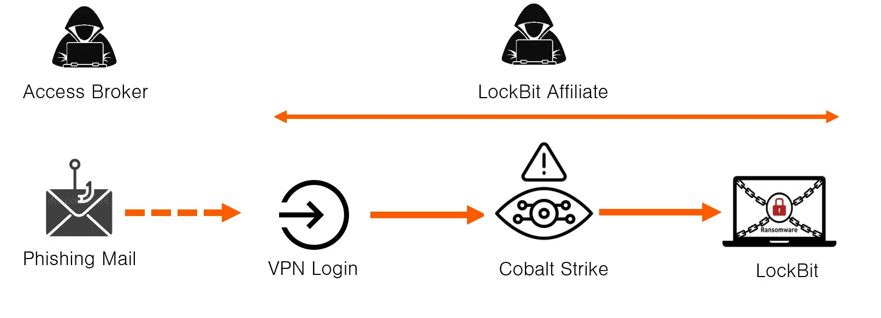

How do we protect ourselves?
Strong Passwords
Multi-factor authentication
Never blindly click a link
Use trusted anti-virus
Keep all systems updated
Regularly back up and store off-site

Slide 6

Sources
https://mashable.com/article/maine-moveit-ransomware-attack#:~:text=In%20a%20new%20notice%20posted,group%20is%20behind%20the%20attack.
https://nypost.com/2023/11/13/business/icbc-chinas-biggest-bank-paid-ransom-lockbit-hackers/
https://thehackernews.com/2023/11/new-ransomware-group-emerges-with-hives.html
https://www.cisa.gov/news-events/cybersecurity-advisories/aa23-165a
https://www.bleepingcomputer.com/news/security/worlds-largest-commercial-bank-icbc-confirms-ransomware-attack/
https://www.cisa.gov/news-events/cybersecurity-advisories/aa23-165a
https://usa.kaspersky.com/resource-center/threats/lockbit-ransomware
https://us.norton.com/blog/privacy/password-statistics
https://denvergazette.com/news/jeffco-hacker-ransom/article_a2e3f094-802e-11ee-b96e-370956f36b22.html#:~:text=The%20hacker%20group%20SingularityMD%20threatened,The%20Denver%20Gazette%20has%20learned

